Slide 1

MOVIE ANALYTICS: THE DATA THAT DRIVES HOLLYWOOD
MSBA TEAM 17: Kishan Patel, Mikey Pedersen, Julia Wilson, Jasmine Yu

Slide 2






Content
Background
Data Warehouse Design
ETL Implementation
Analytics
Results and Conclusion
Appendix

Slide 3
Background Business Challenge and Objectives
Business Challenge
Data Warehouse Objectives
US box office sales have grown sluggishly while attendance has declined. In addition, production companies are facing increasing competition from rival streaming services such as Netflix, Disney+, Apple+, and Hulu for viewership.
Identify key success indicators of film production
Minimize financial risk
Increase revenue and profits
Scope & Objectives
Total Inflation Adjusted Box Office Revenue
1999
2009
2019
$13.4B
$12.9B
$11.1B
Notes:
Introduction
In 2018, the global box office was worth $41.7 billion.^{[1]} When including box office and home entertainment revenue, the global film industry was worth $136 billion in 2018.^{[2]} Hollywood is the world's oldest national film industry, and remains the largest in terms of box office gross revenue.

Slide 4
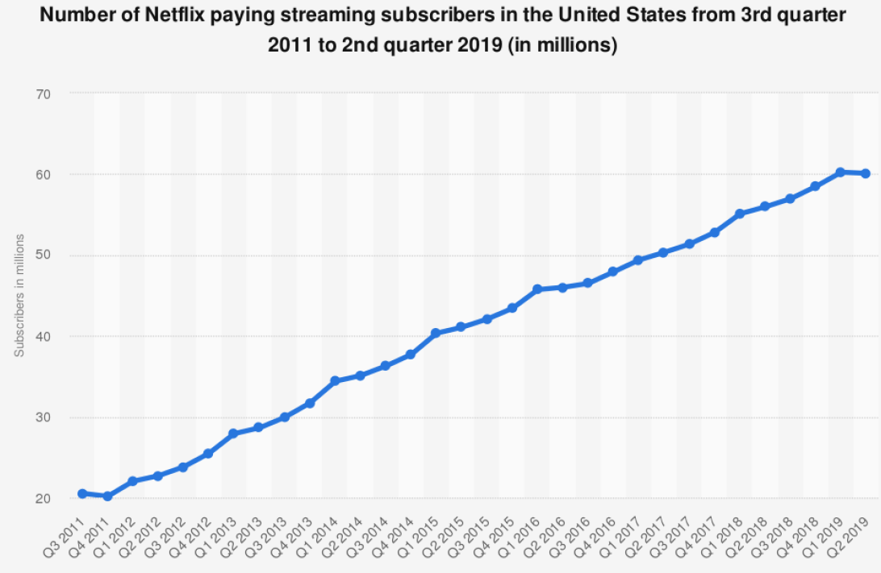
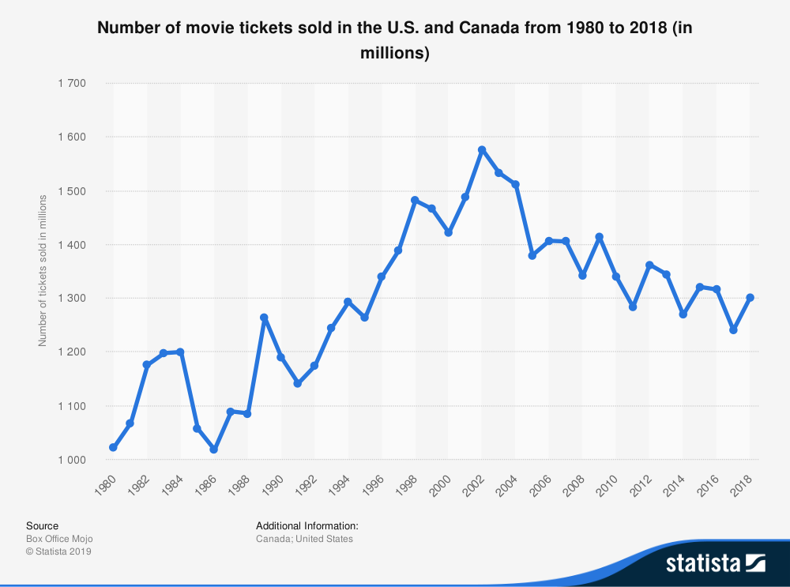
Background Value of Movies and Streaming
Notes:
While big box office records are continuously being broken, the total amount of moviegoers is decreasing
Morning Consult Survey: Primary reasons include ticket price (35%), streaming availability (21%) and inconvenience (13%)

Slide 5
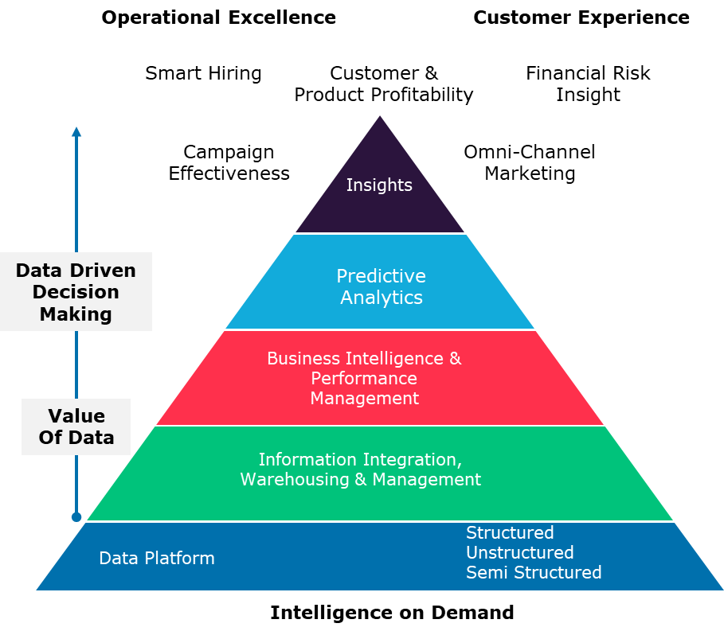
Background Data Driven Decision Making in Hollywood
Optimizing decision processes to embed analytics and insights into
process at the point of decision
Harnessing the power of new tools to provide the insights at the pace
of business that are easy to consume
Leverage information to better understand and optimize
business performance
Establish accurate, trusted information for a single version of the truth,
managed over time
An efficient and solid foundation for managing data and content
over its lifecycle

Slide 6









Data Warehouse Architecture
Data Source
Data Ingestion & Staging
Data Storage
Data Visualization
OMDb API
Extract
Load
Transform

Slide 7
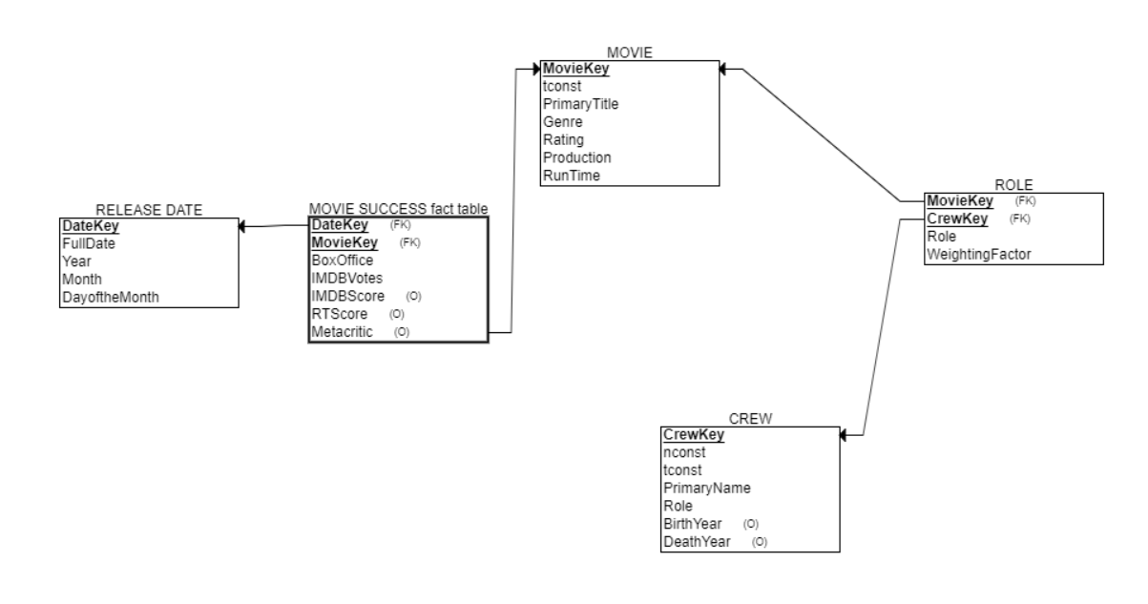
Star Schema

Slide 8
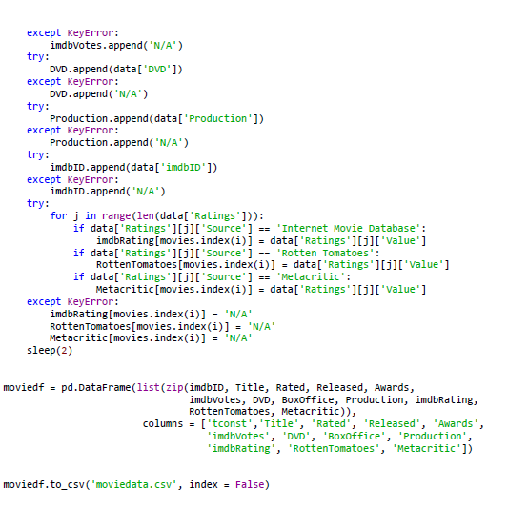
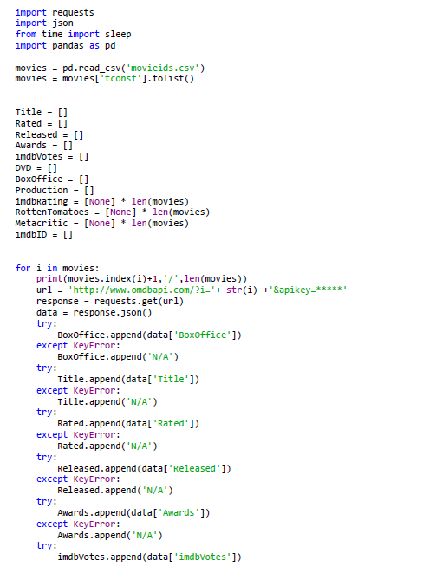
ETL Process
Web Scraping

Slide 9
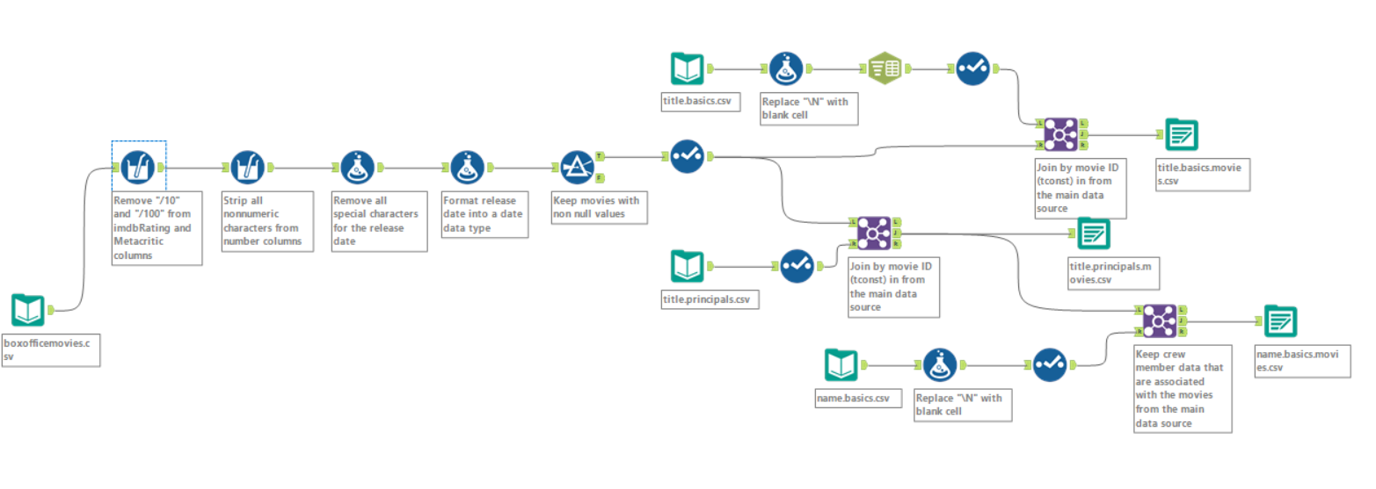
ETL Process
Data Cleaning

Slide 10
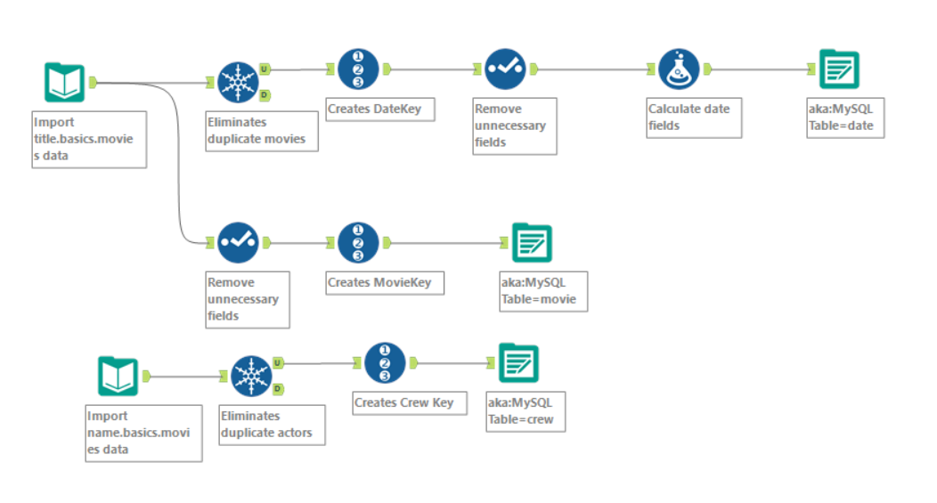
ETL Process
Creating Dimensions

Slide 11
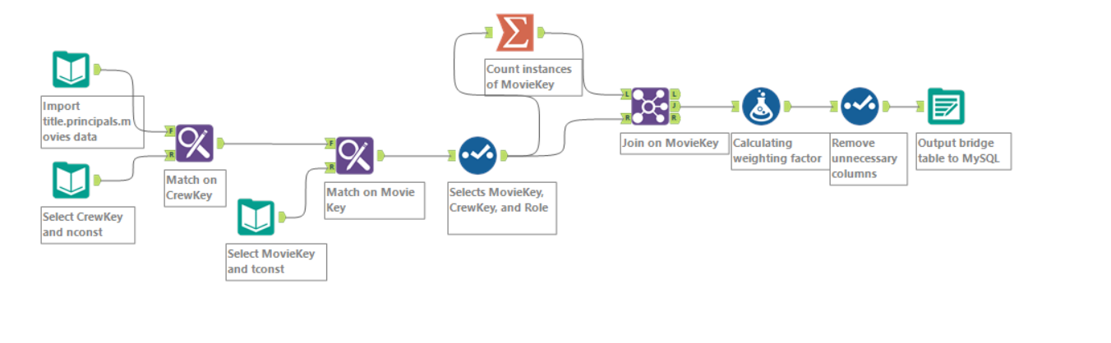
ETL Process
Bridge Table

Slide 12
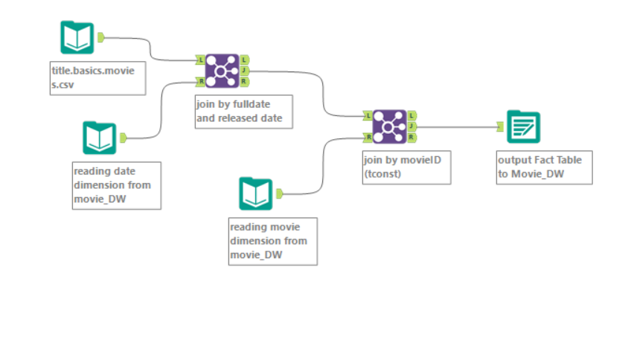
ETL Process
Fact Table

Slide 13
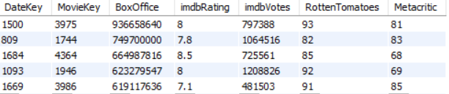
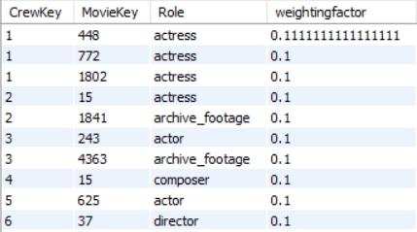
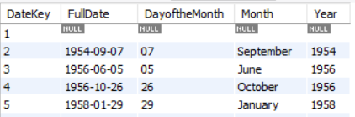
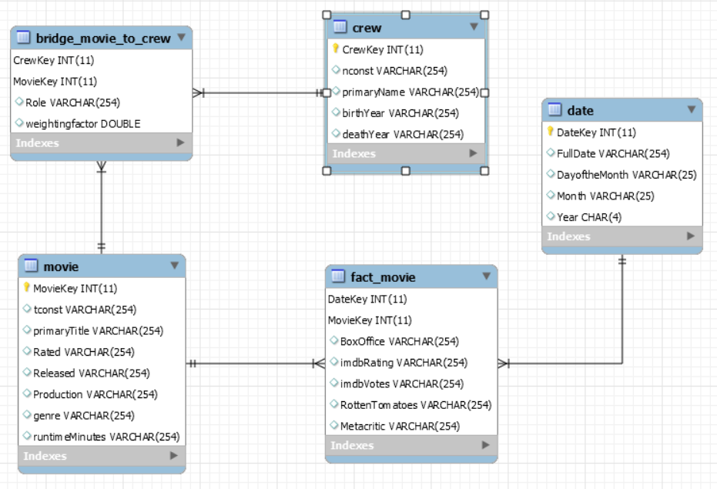
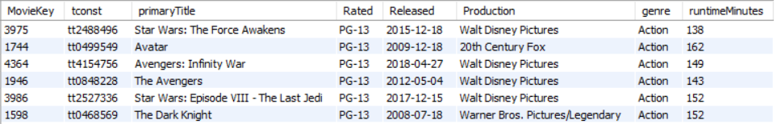
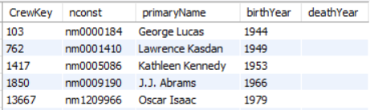
Final MySQL Results
Fact Table
Bridge Table
Dimensions
Date
Schema
Movie
Crew

Slide 14
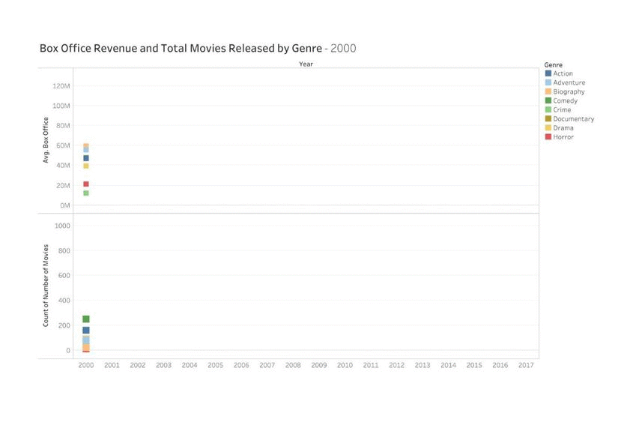
Analytics: How Do Genres Change Over Time?

Slide 15
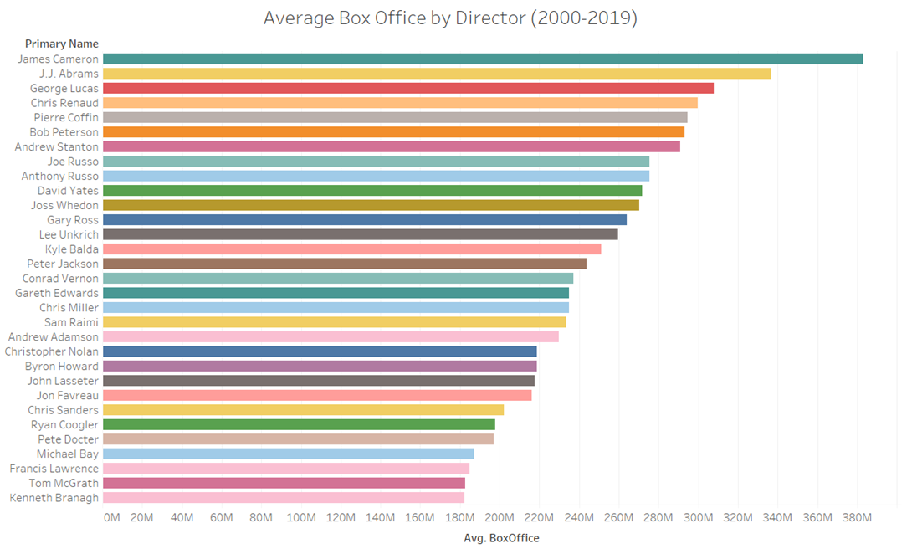
Analytics: What is the Average Box Office Revenue for a Director?

Slide 16
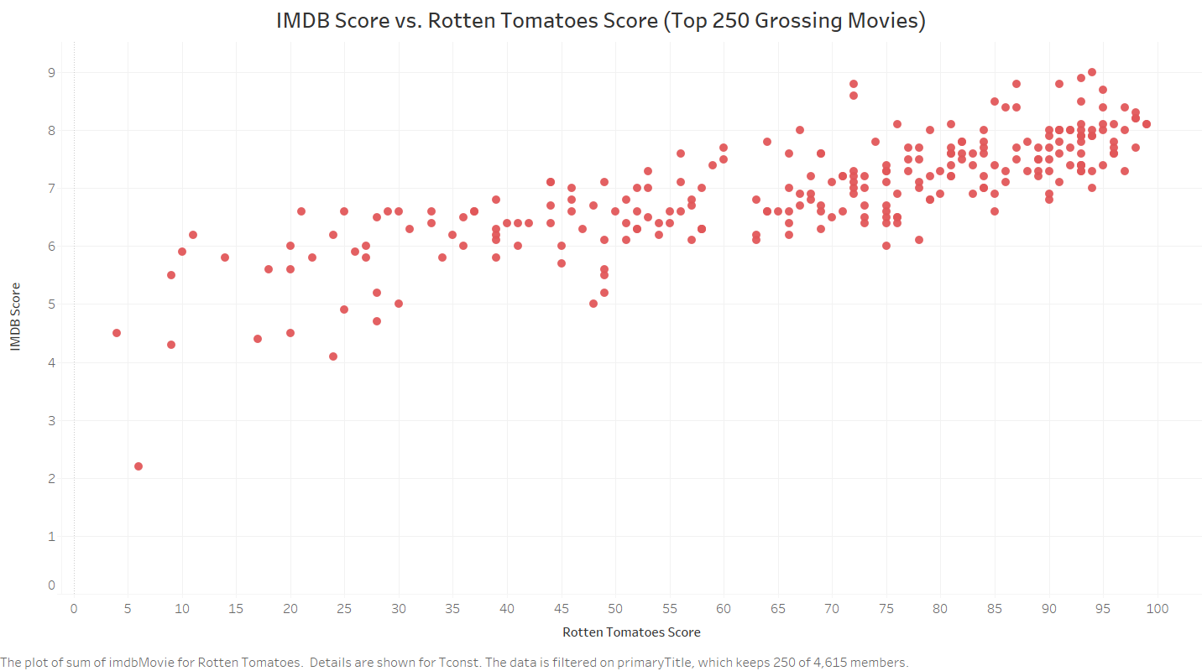
Analytics: Are IMDB Score and Rotten Tomatoes Scores Correlated?

Slide 17
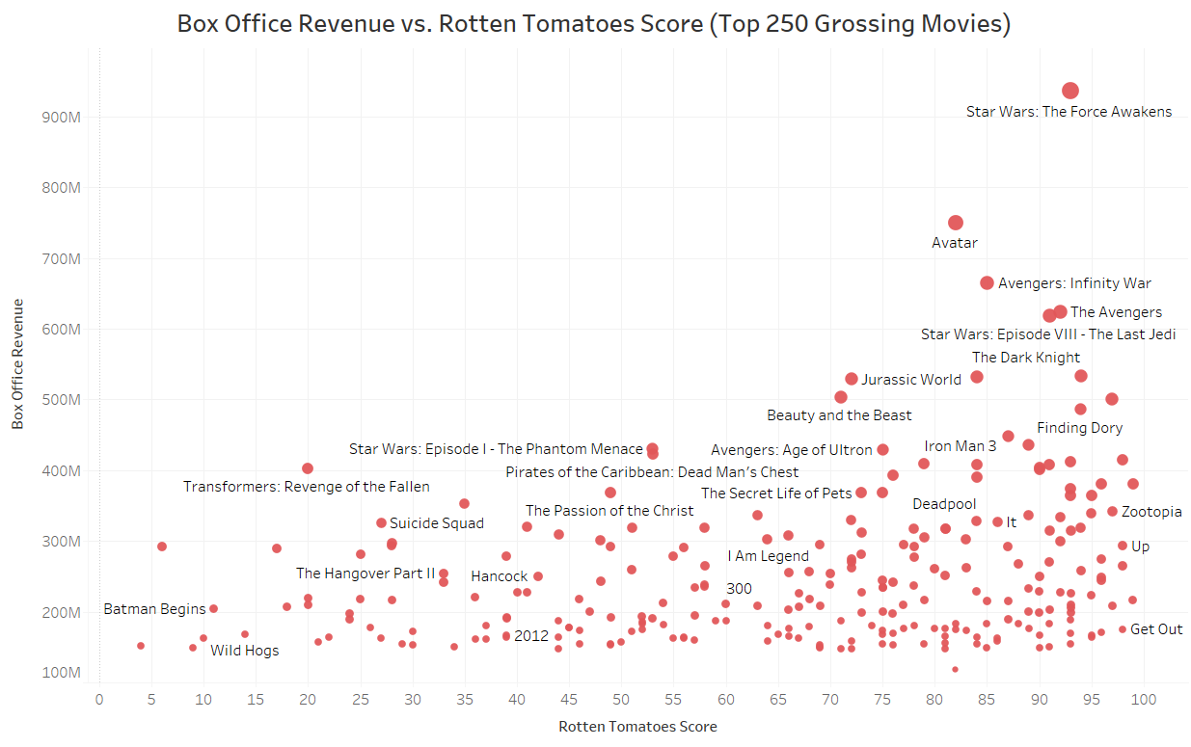
Analytics: How does the Rotten Tomatoes Score Relate to Box Office Revenue?

Slide 18
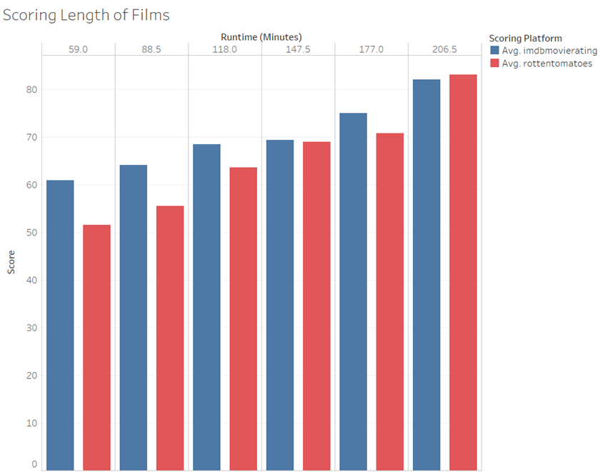
Analytics: How Does Movie Length Affect Ratings?

Slide 19



Conclusion Challenges & Lessons Learned
Judicious Decision Making
Data quality issues
Double counting issue
To overcome data quality and management issues
Web scraping data can be a time consuming process
Modeling a database is not a linear process (backtracking frequently occurred)
New concepts: bridge table and weighting factor

Slide 20
Conclusion Next Steps
Find more data sources and perform fuzzy matching
Add streaming data (Netflix, Hulu, etc.)
Make comparisons between box office and streaming data
Identify streaming trends
Create a customer dimension and integrate census data
Incorporate social media data

Slide 21
Appendix

Slide 22
References
https://www.statista.com/statistics/187073/tickets-sold-at-the-north-american-box-office-since-1980/
https://www.statista.com/statistics/250937/quarterly-number-of-netflix-streaming-subscribers-in-the-us/
https://www.statista.com/statistics/815500/reason-watch-fewer-movies-us/
https://www.the-numbers.com/
http://www.omdbapi.com/
https://www.imdb.com/

Slide 23
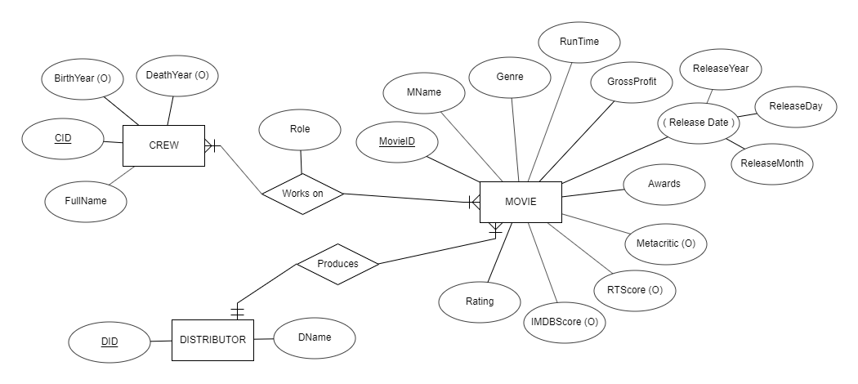
ER Diagram

Slide 24
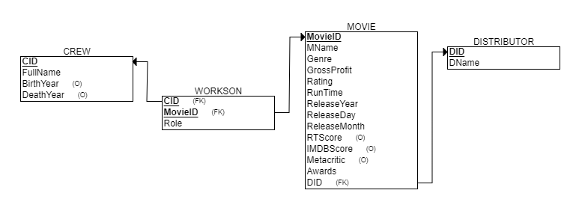
Relational Schema

